Slide 1

DEEP NEURAL NETWORK MODULE # 3 : LINEAR NEURAL NETWORKS FOR REGRESSION
DNN Team
BITS Pilani WILP

Slide 2
The instructor is gratefully acknowledging the authors who made their course materials freely available online.
This deck is prepared by Seetha Parameswaran.
Deep Learning

Slide 3








Table of Contents
Regression
Linear Regression
The Linear Model: Single Neuron
Worked Example
Evaluation
Python Implementation Implementation Tips
Summary
1
2
3
4
5
6
7
8
Deep Learning

Slide 4
What is Regression?
Definition
Regression is a supervised learning task that predicts a continuous-valued output based on input features.
Key Characteristics:
Input: Feature vector x ∈ R^{d}
Output: Real-valued target y ∈ R
Goal: Learn a function f : R^{d} → R such that y ≈ f (x)
Deep Learning

Slide 5
Examples of Regression Problems
House Price Prediction
Input: Size, location, number of rooms
Output: Price in dollars
Temperature Forecasting
Input: Historical weather data, season, humidity
Output: Temperature in degrees
Stock Price Prediction
Input: Historical prices, trading volume, market indicators
Output: Future stock price
1
2
3
Deep Learning

Slide 6


Table of Contents
Regression
Linear Regression
The Linear Model: Single Neuron
Worked Example
Evaluation
Python Implementation Implementation Tips
Summary
1
2
3
4
5
6
7
8
Deep Learning

Slide 7
What is Linear Regression?
Definition
Linear regression assumes the output is a linear combination of the input features.
Mathematical Form:
y = w₀ + w₁x₁ + w₂x₂ + · · · + w_{d}x_{d}
(1)
where:
x = [x₁, x₂, . . . , x_{d} ]^{T} are the input features
w = [w₁, w₂, . . . , w_{d} ]^{T} are the weights
w₀ is the bias term
Deep Learning

Slide 8
Examples of Linear Regression
1
Salary Prediction
Salary = w₀ + w₁ × Years of Experience
2
Crop Yield Prediction
Yield = w₀ + w₁ × Rainfall + w₂ × Fertilizer
3
Energy Consumption
Energy = w₀ + w₁ × Temperature + w₂ × Hour + w₃ × Day
The relationship between inputs and output is assumed to be linear.
Deep Learning

Slide 9
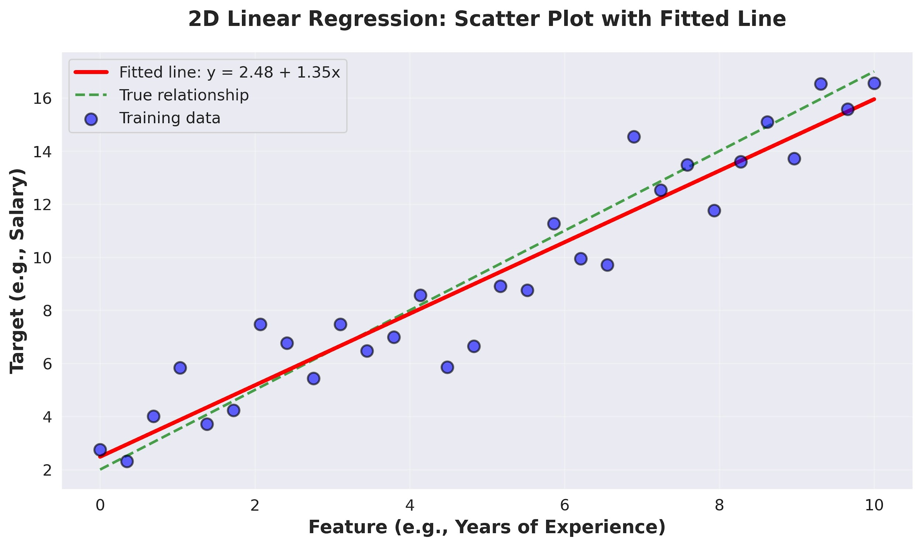
Visual Example: 2D Linear Regression
Deep Learning

Slide 10

Table of Contents
Regression
Linear Regression
The Linear Model: Single Neuron
Worked Example
Evaluation
Python Implementation Implementation Tips
Summary
1
2
3
4
5
6
7
8
Deep Learning

Slide 11
The Four Components
A complete machine learning system consists of:
1
Data: d -dimensional input vectors and target outputs Model: Single neuron implementing linear function Objective Function: Measures prediction error
Learning Algorithm: Gradient descent to optimize weights
2
3
4
Deep Learning

Slide 12
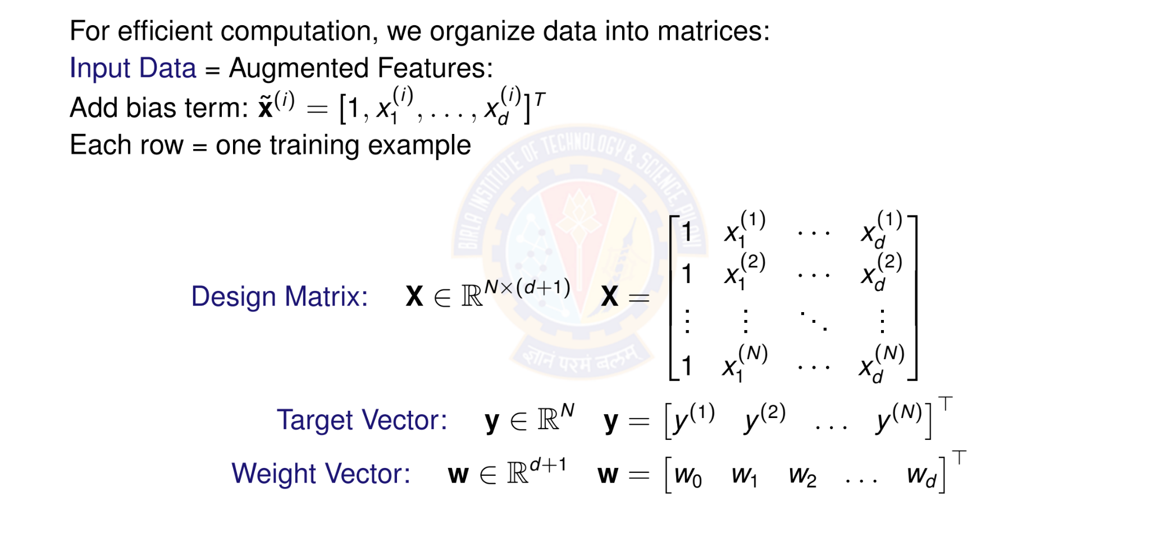
Matrix Form of Data
Deep Learning

Slide 13

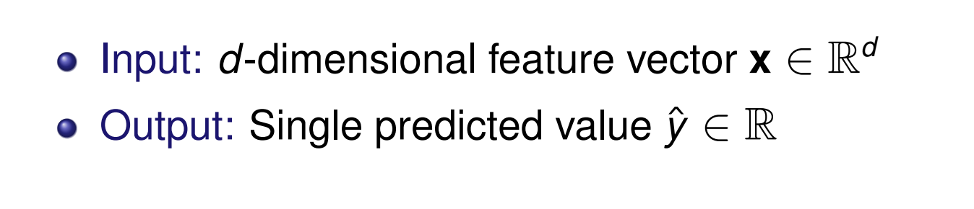
Linear Model as a Single Neuron
Model linear regression as a single artificial neuron:
1
x₁
w₀ w₁ w₂
f
Σ
y^{ˆ}
x
2
.
x_{d}
.
w_{d}
Deep Learning

Slide 14
Linear Model Prediction
Model: A single neuron computes a weighted sum and applied identity activation function.
Prediction for input x:
y^{ˆ} = f (w^{T} x) = f (w₀ + w₁x₁ + w₂x₂ + · · · + w_{d} x_{d} )
(2)
where:
w = [w₀, w₁, . . . , w_{d} ]^{T} ∈ R^{d +1} are the model parameters
x = [1, x₁, . . . , x_{d} ]^{T} ∈ R^{d +1} is the input
f (·) is the identity activation f (z) = z
Vectorized form: for all predictions
y^{ˆ} = Xw
(3)
Deep Learning

Slide 15
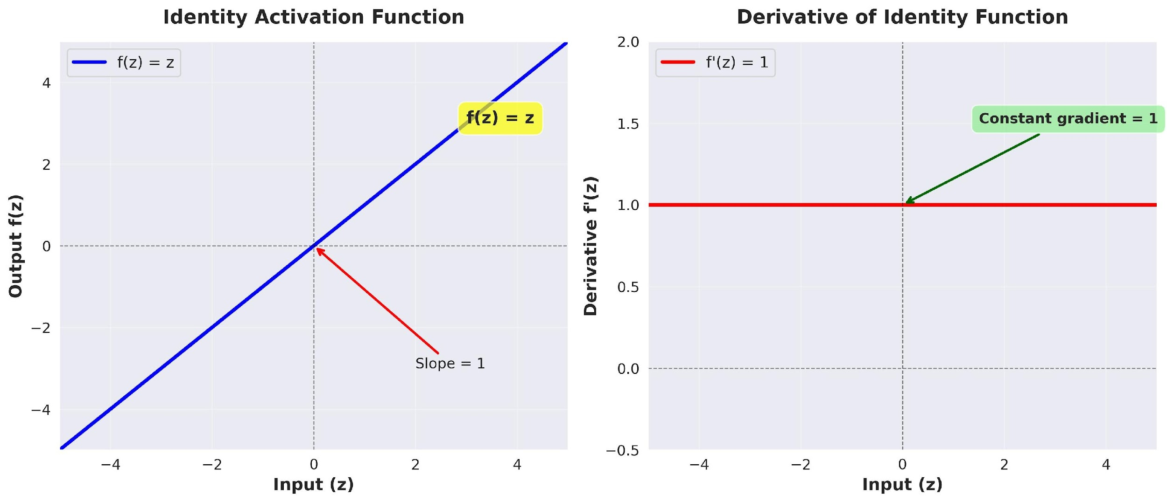
Identity Activation Function
Identity Activation Function
f (z) = z
(4)
Deep Learning

Slide 16
Identity Activation Function
Properties of Identity Function Output: Continuous, (−∞, ∞)
Differentiable everywhere: f '(z) = 1 Allows output to take any real value
Gradient flows unchanged through the neuron Perfect for predicting continuous targets
Why identity for regression?
Target values are continuous (prices, temperatures, etc.) Need to predict any real number, not just binary { 0,1 } Differentiability enables gradient-based optimization
No information loss from input to output
Deep Learning

Slide 17
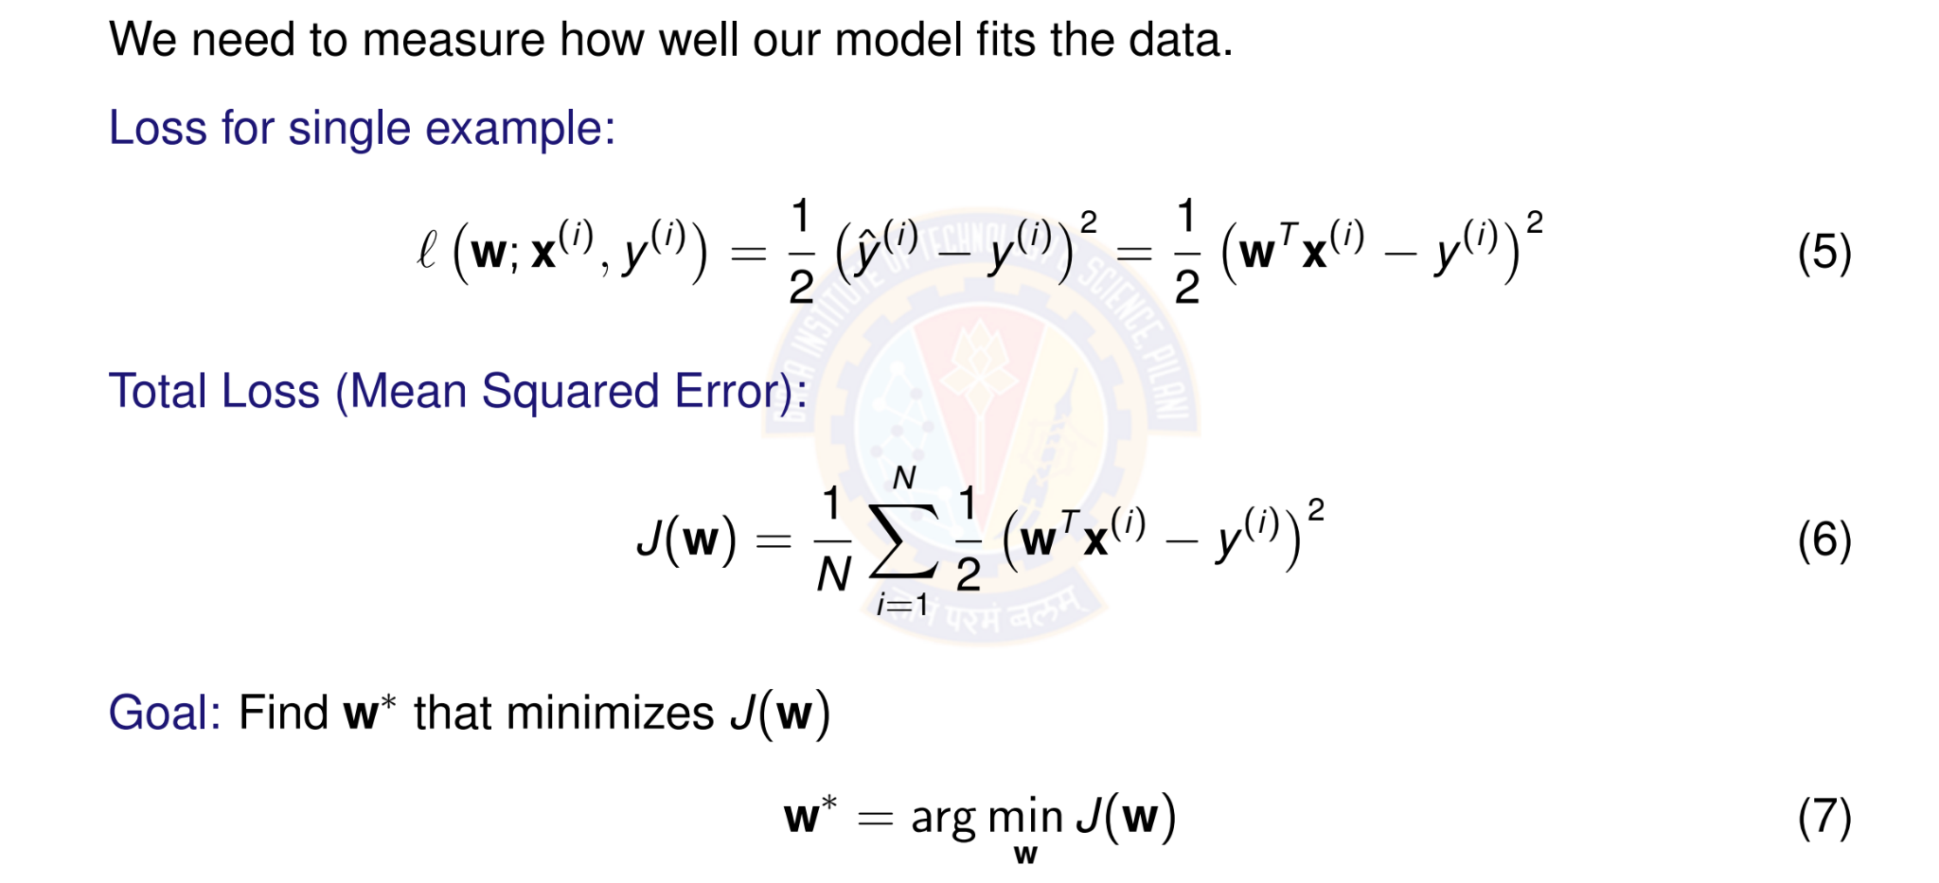
Objective Function: Squared Error Loss
Deep Learning

Slide 18
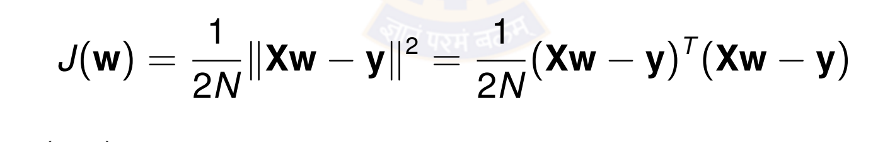
Why Squared Error?
Advantages of squared error loss:
Differentiable: Smooth everywhere, easy to optimize Convex: Single global minimum (for linear models) Penalizes large errors: Quadratic growth
Statistical interpretation: Maximum likelihood under Gaussian noise
Vector Form:
(8)
where X ∈ R^{N×(d +1)} is the design matrix and y ∈ R^{N} is the target vector.
Deep Learning
Notes:
The squared error loss, commonly known as Mean Squared Error (MSE), is a widely used objective function in neural networks, particularly for regression tasks where the goal is to predict continuous numerical values.
Definition and Calculation:
The MSE loss quantifies the average of the squared differences between the predicted output of the neural network and the true, or actual, target values.
Differentiable: This allows for the efficient calculation of gradients needed to update the network's parameters.
Convexity: FFor a given set of 𝑁 data points, where yi represents the true value and ${\hat{y}}_{i}$ represents the predicted value for the 𝑖-th data point
or many simpler models, MSE can be a convex function, meaning there is a single global minimum that optimization algorithms can reliably find.
Smoothness: Its smooth nature facilitates the optimization process.

Slide 19
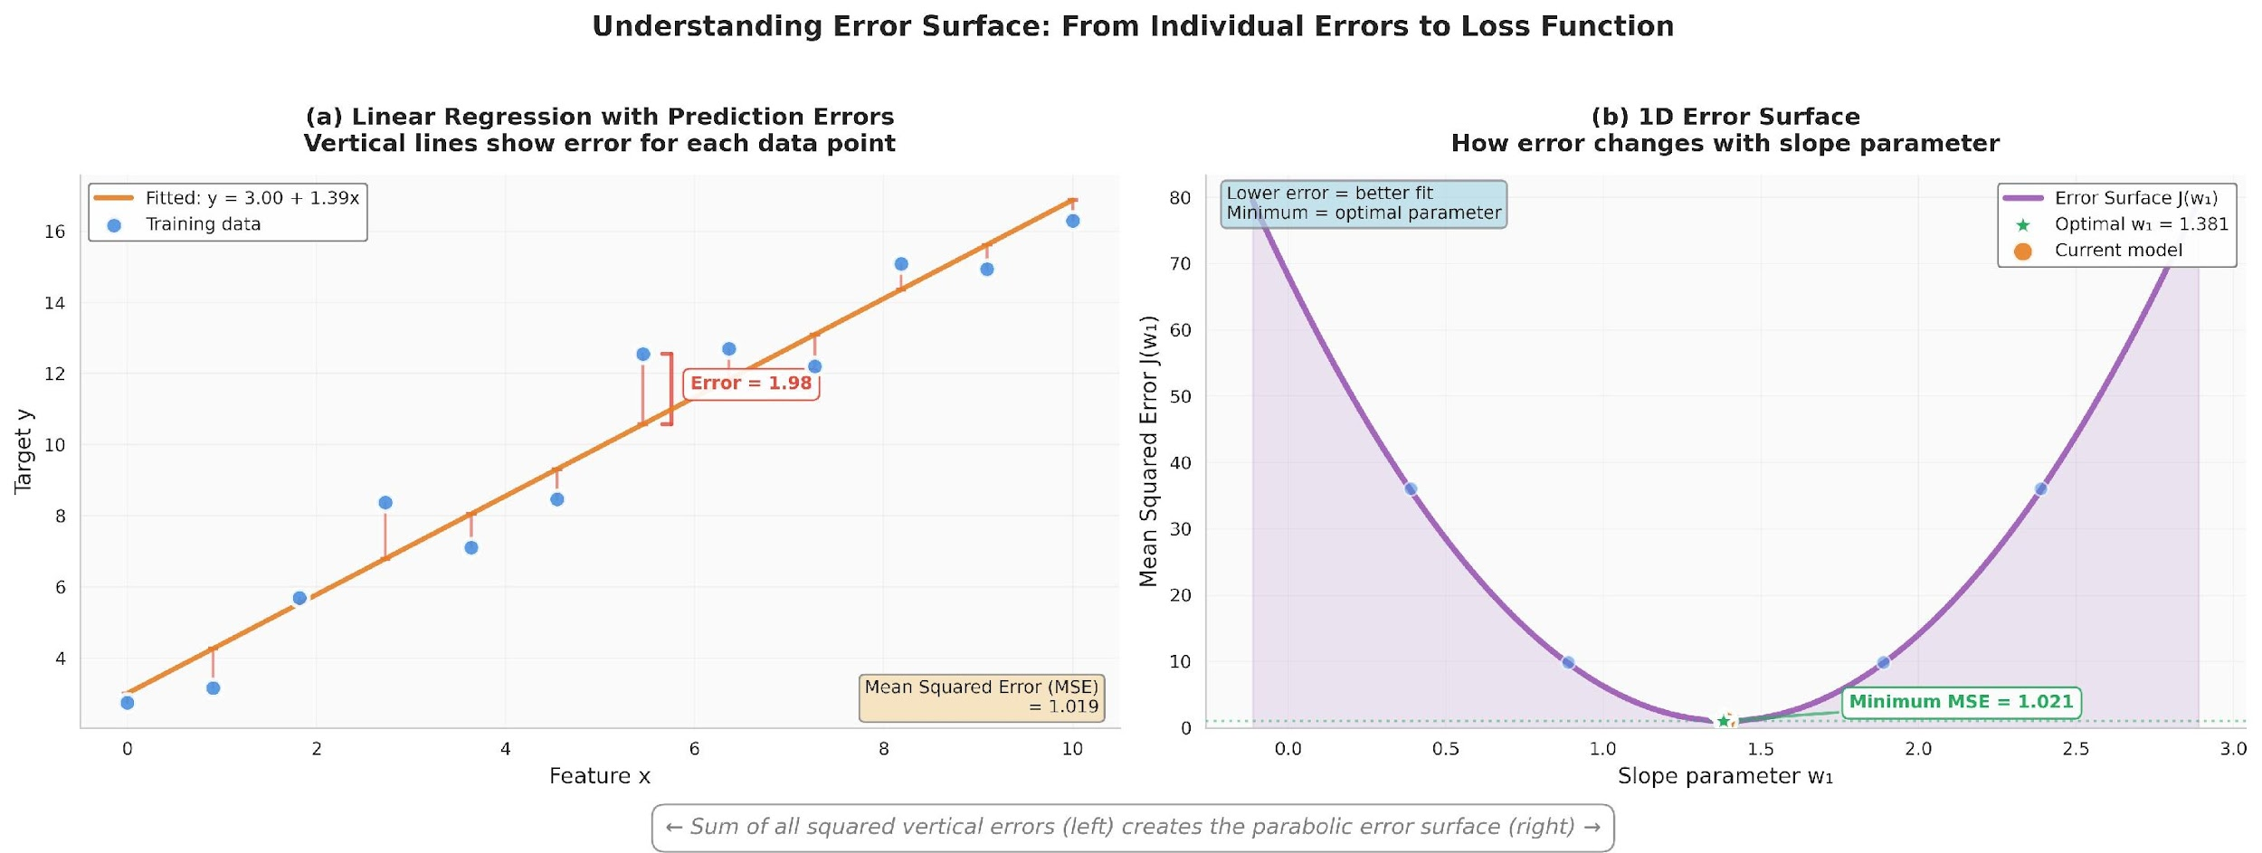
Visualizing the Error Surface
The error surface is convex with a single global minimum.
Deep Learning
Notes:
Part (a) Linear Regression with Prediction Errors: This graph displays training data points and a fitted line representing a linear model.
The vertical lines represent the error (or residual) for each data point, which is the difference between the actual target value and the value predicted by the model.
The goal of linear regression is to minimize these errors.
Part (b) 1D Error Surface: This graph shows how the Mean Squared Error (MSE) changes as a single model parameter (the slope, $w$) is adjusted.
The MSE is calculated by summing the squares of all the individual errors from the left graph.
The resulting curve is parabolic, known as the error or cost surface.
The lowest point of this curve (the minimum MSE) corresponds to the optimal parameter value (optimal $w$) that provides the best fit line for the data.
Finding this minimum is the objective of optimization algorithms like gradient descent.

Slide 20
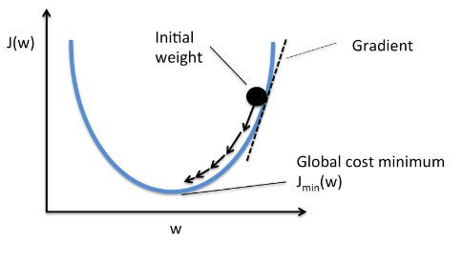
Gradient Descent Algorithm
Idea: Iteratively update weights in the direction of steepest descent
where η > 0 is the learning rate (step size).
Intuition: Move downhill on the error surface to find the minimum.
Deep Learning
Notes:
Cost Function: The curve represents the cost function, labeled $J\left(w\right)$on the vertical axis. This function measures the "cost" or error of the model's predictions based on a given weight parameter 'w' on the horizontal axis.
Objective: The goal of the algorithm is to find the parameter 'w' that minimizes the cost function, reaching the "Global cost minimum", $J_{min}\left(w\right)$ .
Initial Point: The process begins at an "Initial weight" (the black dot), a randomly chosen starting point on the cost function curve.
Gradient and Iteration: The "Gradient" (dashed line) represents the slope of the tangent at the current point. The algorithm iteratively updates the weight by moving in the direction opposite to the gradient (down the slope), as indicated by the arrows. This process is repeated until the minimum is reached, effectively minimizing the model's error. The update rule is typically $w=w−η⋅∇J\left(w\right)$, where $η$is the learning rate and $∇J\left(w\right)$ is the gradient.

Slide 21
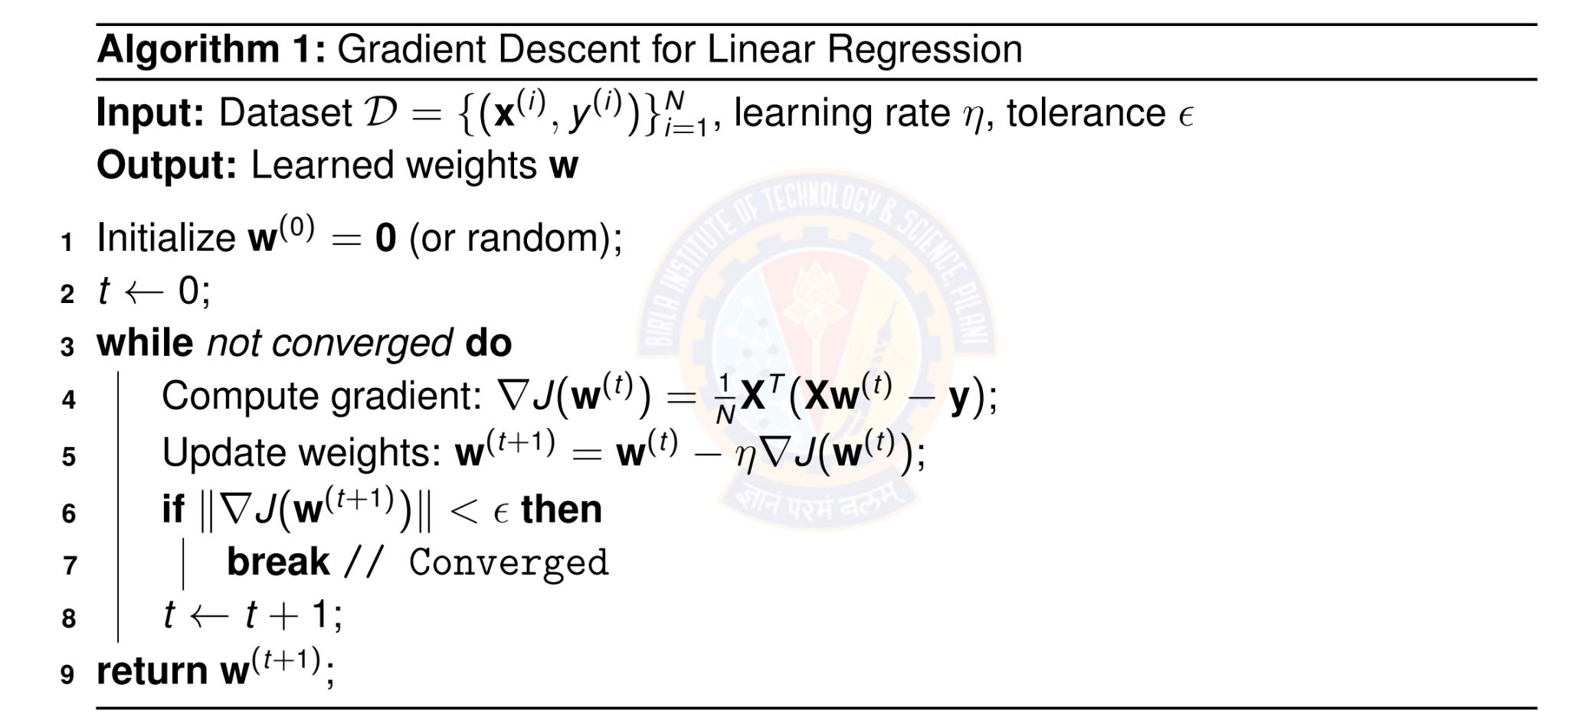
Batch Gradient Descent Algorithm
Deep Learning

Slide 22
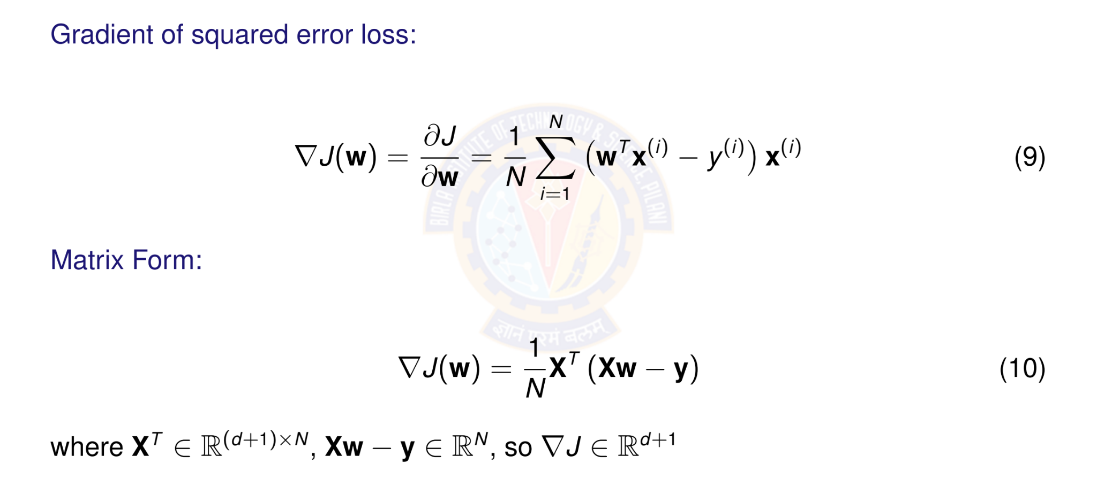
Computing the Gradient
Deep Learning
Notes:
In a neural network, the gradient is a vector that represents the direction and magnitude of the steepest ascent of the loss function. It is calculated using the partial derivatives of the loss function with respect to each of the network's parameters (weights and biases). During training, this information is used to guide the process of gradient descent, which adjusts the parameters in the opposite direction of the gradient to minimize the loss and improve the model's predictions

Slide 23
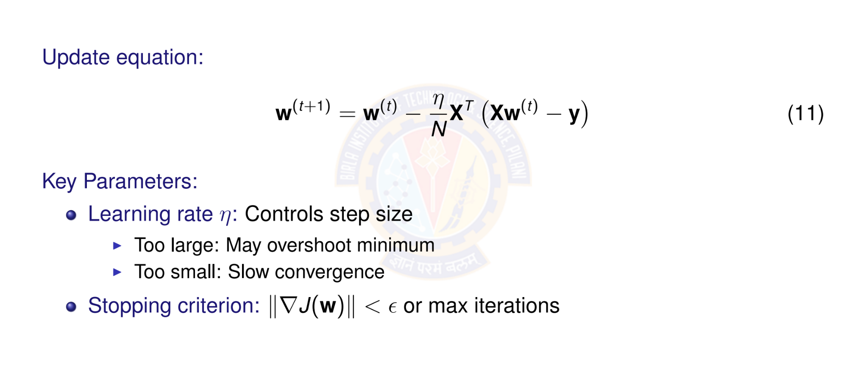
Gradient Descent Update Rule
Deep Learning
Notes:
This formula represents a step in the direction opposite to the gradient of a cost function, scaled by a learning rate $η$
Learning rate ($η$): This parameter controls the step size taken during each update. If too large, the algorithm may overshoot the minimum of the cost function.
If too small, the convergence to the minimum will be slow.
Stopping criterion: This condition determines when the optimization process should stop. The process terminates when: The norm of the gradient of the cost function, is less than a small value $ε$.
A maximum number of iterations has been reached.

Slide 24
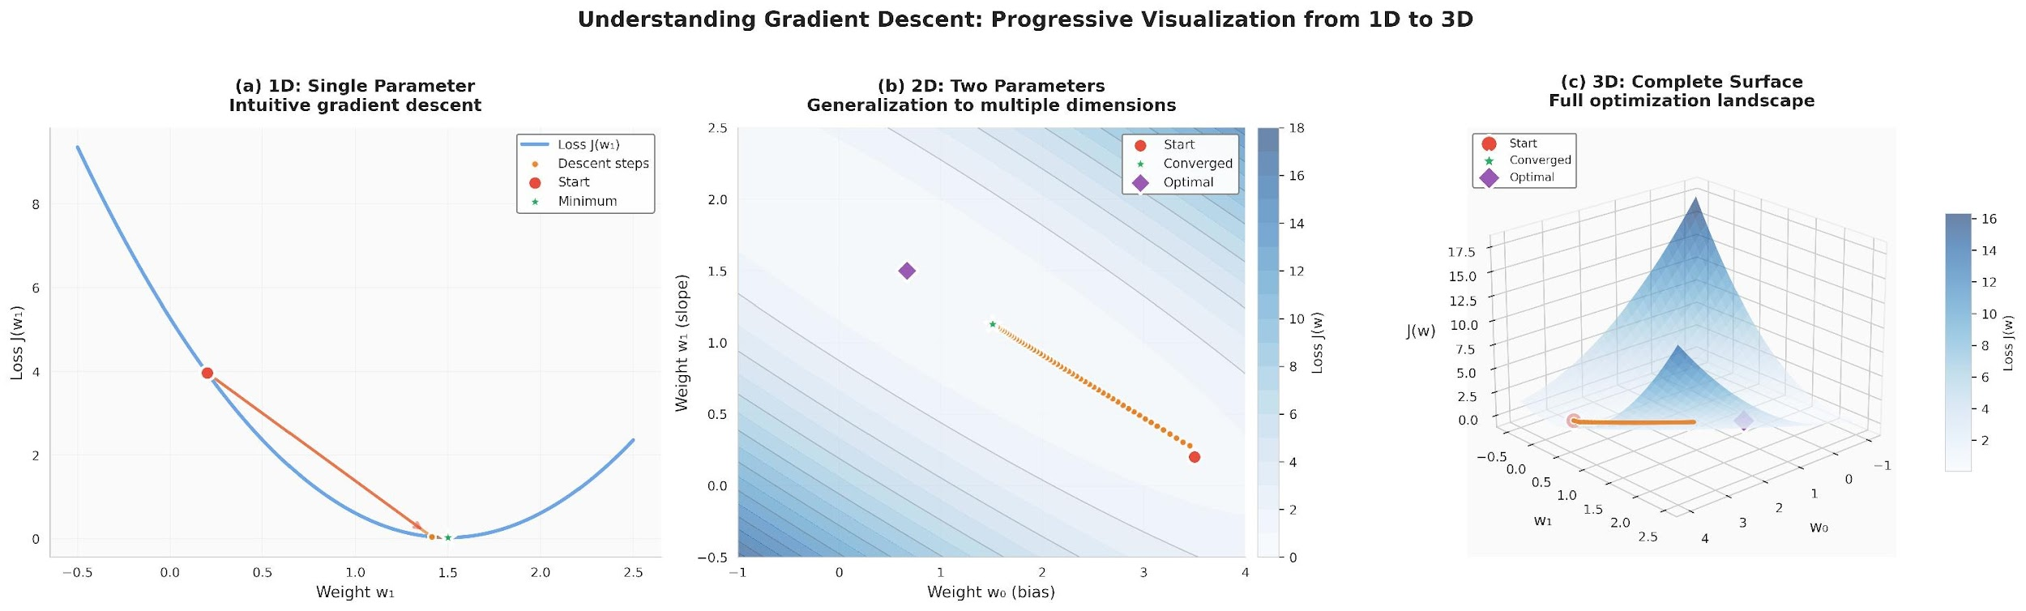
Visualizing Gradient Descent
Each step moves perpendicular to contour lines toward the minimum.
Deep Learning
Notes:
1D: Single Parameter (a): This graph shows a simple, one-dimensional loss function (Loss $J\left(w\right)$ versus Weight $w$).
The red line and points illustrate the steps taken by the gradient descent algorithm from a starting point (Start) towards the minimum point. The straight lines in the first graph appear to indicate a consistent $J$ value for points along them.
2D: Two Parameters (b): This plot generalizes the concept to two parameters (Weight $w_{1}$and Weight $w_{2}$). It uses a contour map to show the loss function landscape. The path from the start point (red diamond) shows the algorithm navigating the contours to reach the optimal point (purple diamond).
3D: Complete Surface (c): This three-dimensional surface plot provides a full view of the optimization landscape for the two-parameter function. It visually demonstrates the "descent" down the surface of the loss function towards the lowest point, which represents the optimal set of parameters.

Slide 25

Table of Contents
1
Regression
Linear Regression
The Linear Model: Single Neuron
Worked Example
Evaluation
Python Implementation Implementation Tips
Summary
2
3
4
5
6
7
8
Deep Learning

Slide 26
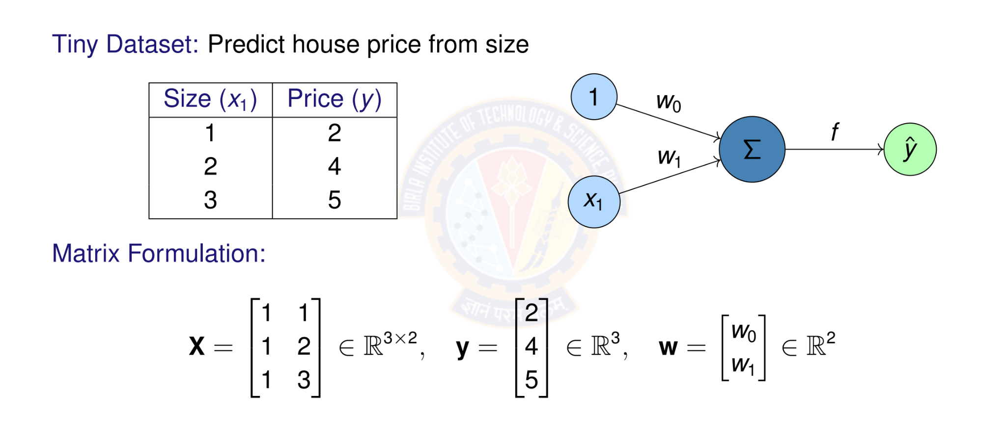
Numerical Example: Setup
Deep Learning

Slide 27
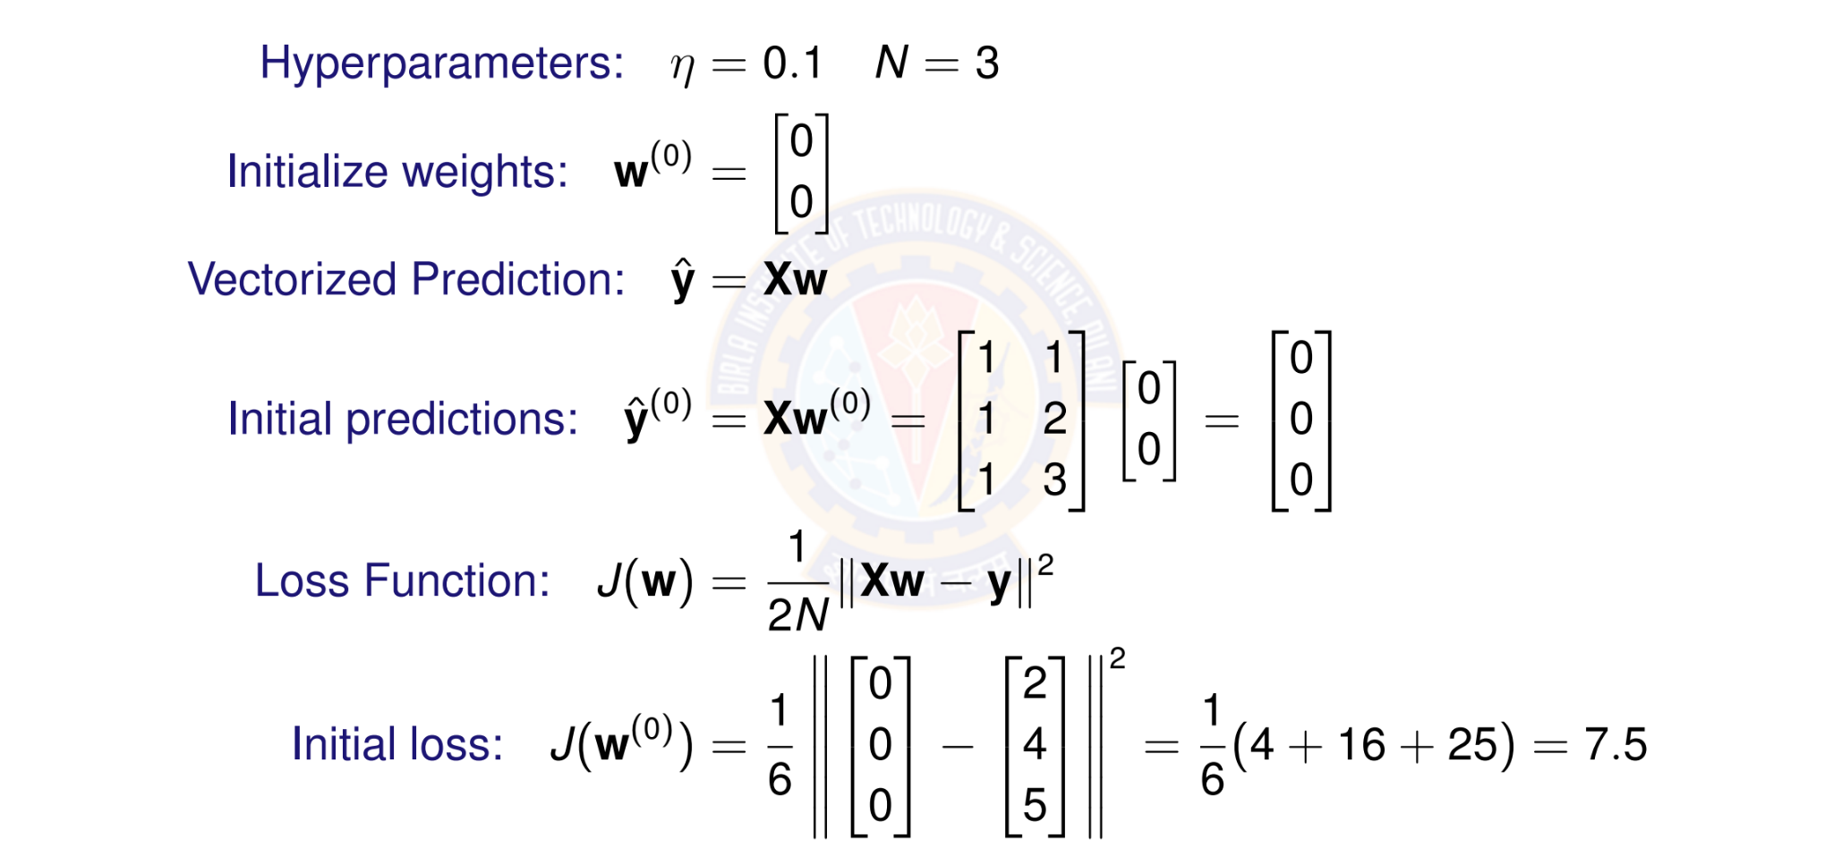
Numerical Example: Initialization
Deep Learning

Slide 28
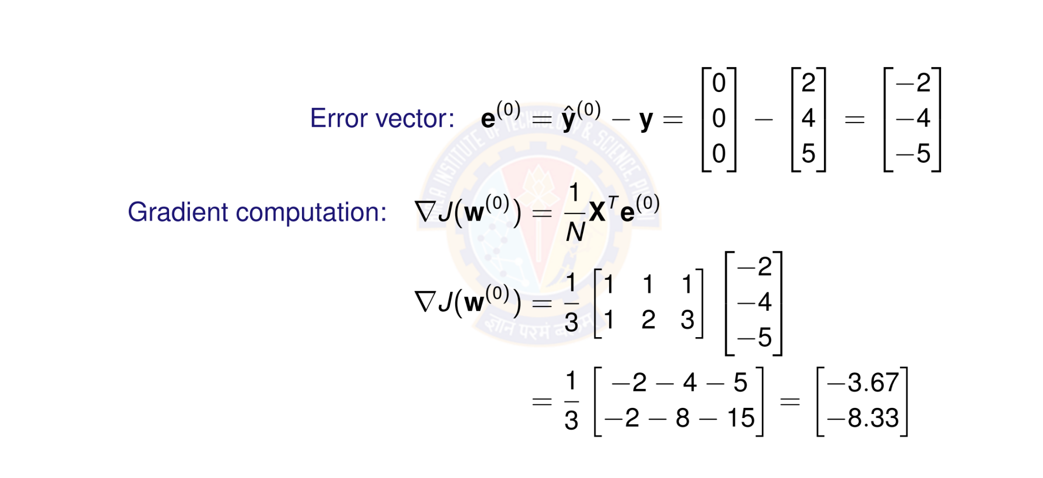
Numerical Example: Computing Gradient
Deep Learning

Slide 29
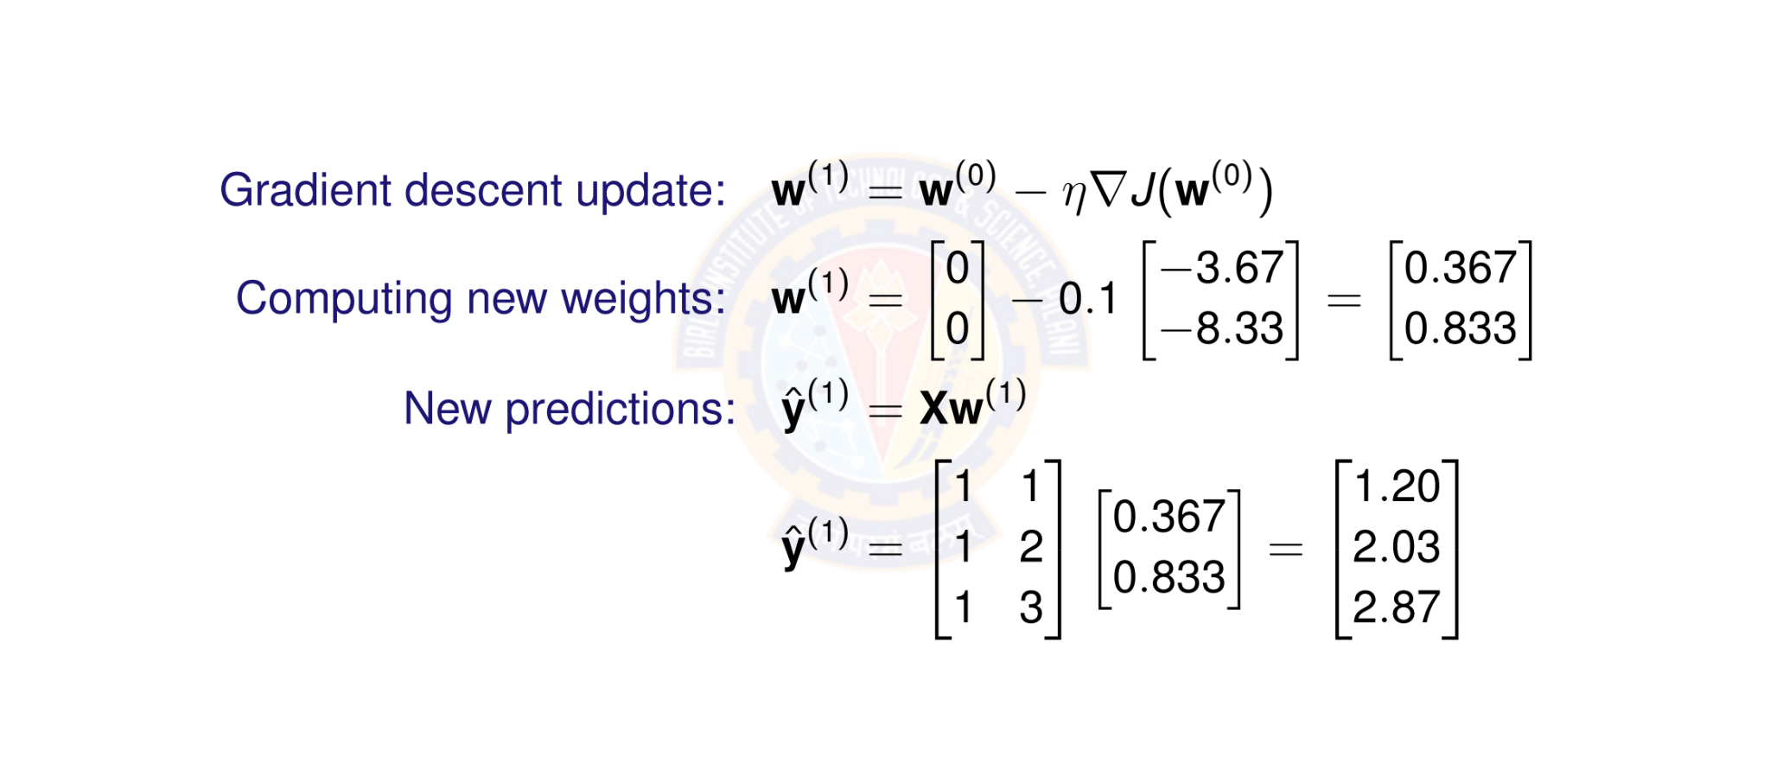
Numerical Example: Weight Update
Deep Learning

Slide 30
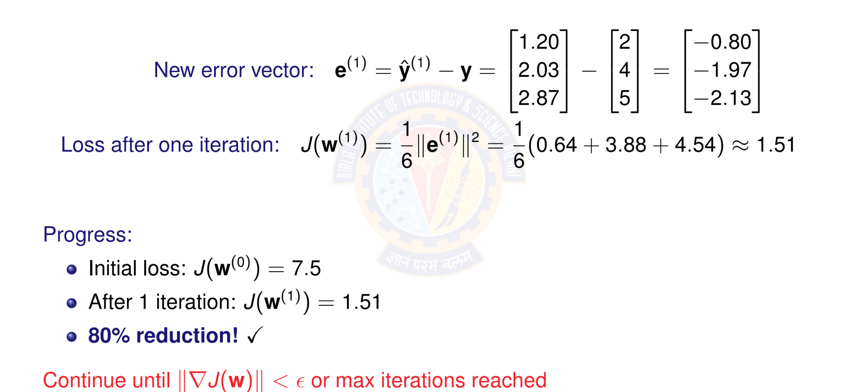
Numerical Example: New Loss
Deep Learning

Slide 31
Computational Graph for One Gradient
Parameters Input Data Targets
_{w}(t )
 | —η
X
y
Updated
_{w}(t +1)
×
∇J
_{X}T
y^{ˆ}
—
Loss
1 _{e}
∇J
N
e
·
2
J(w)
Deep Learning

Slide 32

Table of Contents
Regression
Linear Regression
The Linear Model: Single Neuron
Worked Example
Evaluation
Python Implementation Implementation Tips
Summary
1
2
3
4
5
6
7
8
Deep Learning

Slide 33
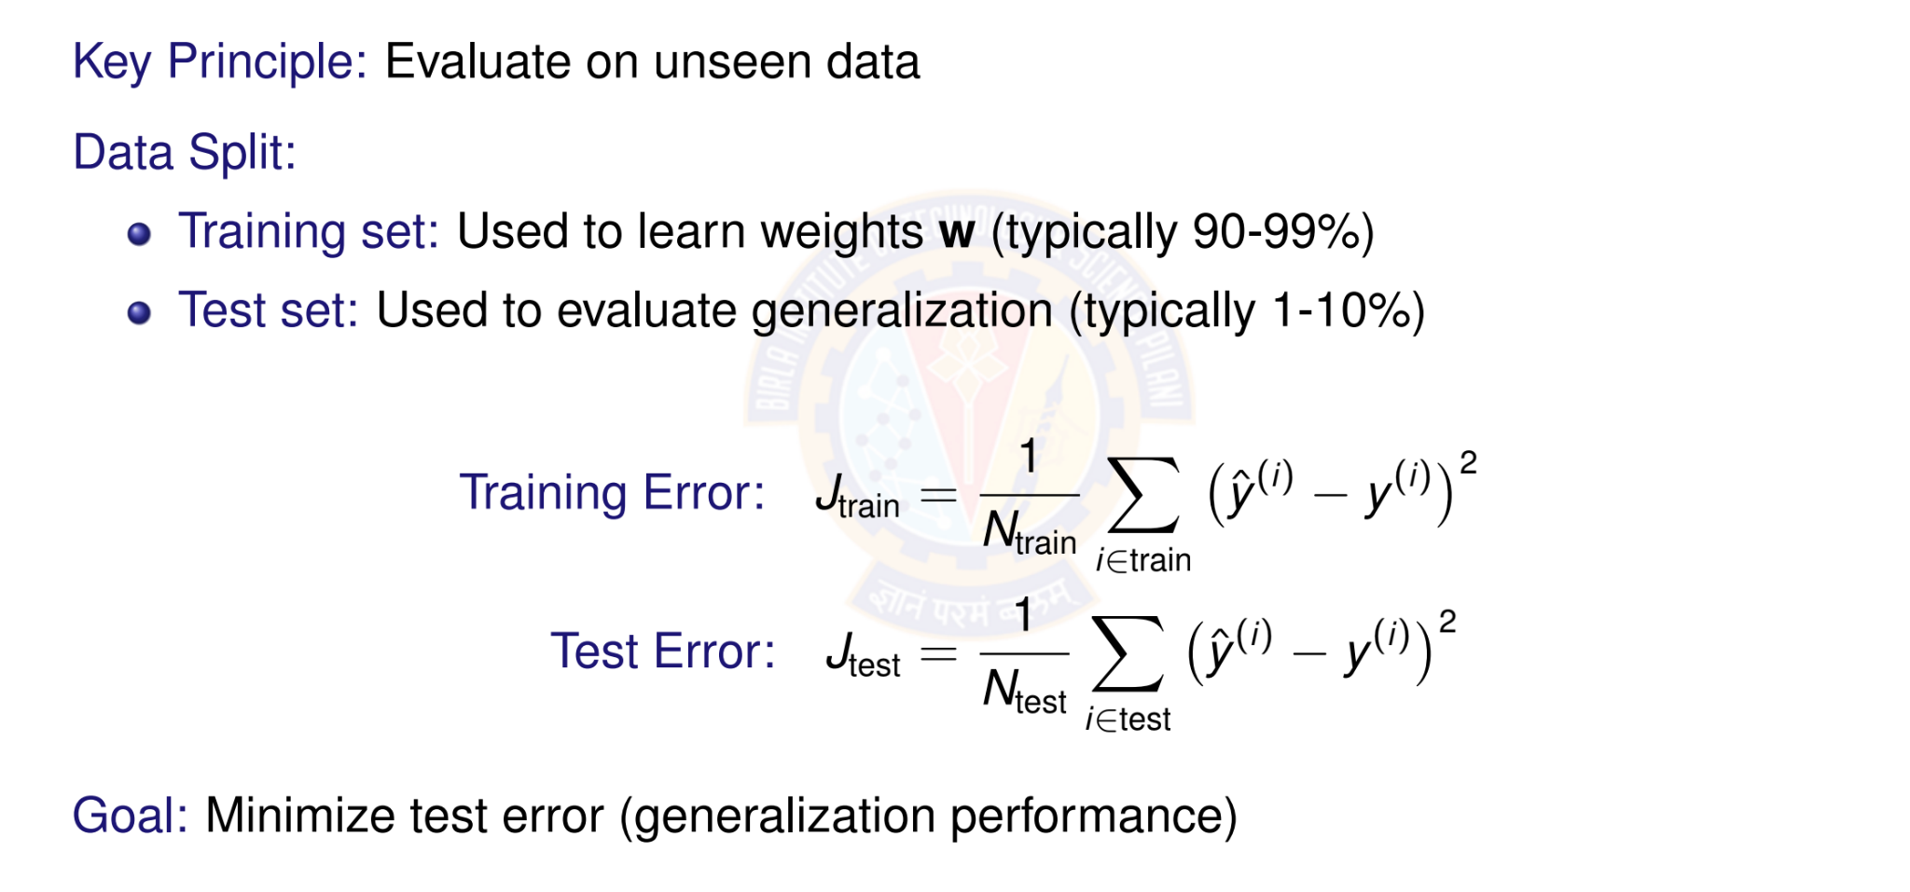
Model Evaluation: Training vs Test Error
Deep Learning

Slide 34
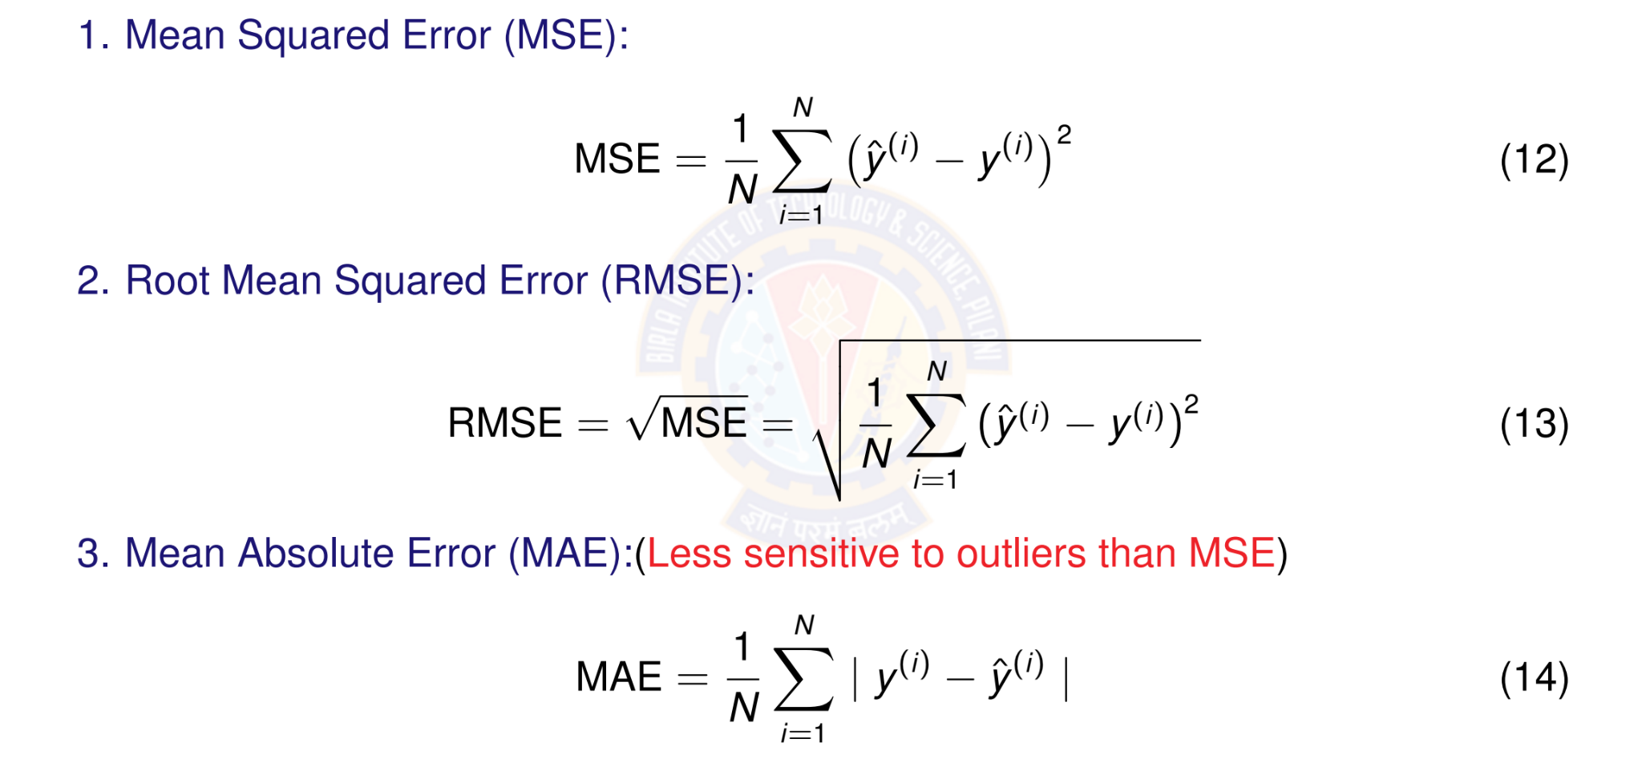
Evaluation Metrics
Deep Learning
Notes:
Root Mean Absolute Error (RMSE) is a metric used to measure the difference between predicted and actual values in a dataset, calculated by taking the square root of the average of the squared differences between the predicted and actual values.
Mean Absolute Error (MAE) is a metric that measures the average magnitude of the errors between paired observations, such as predicted versus actual values. It is calculated by taking the average of the absolute differences between the predicted and actual values, making it robust to outliers.

Slide 35
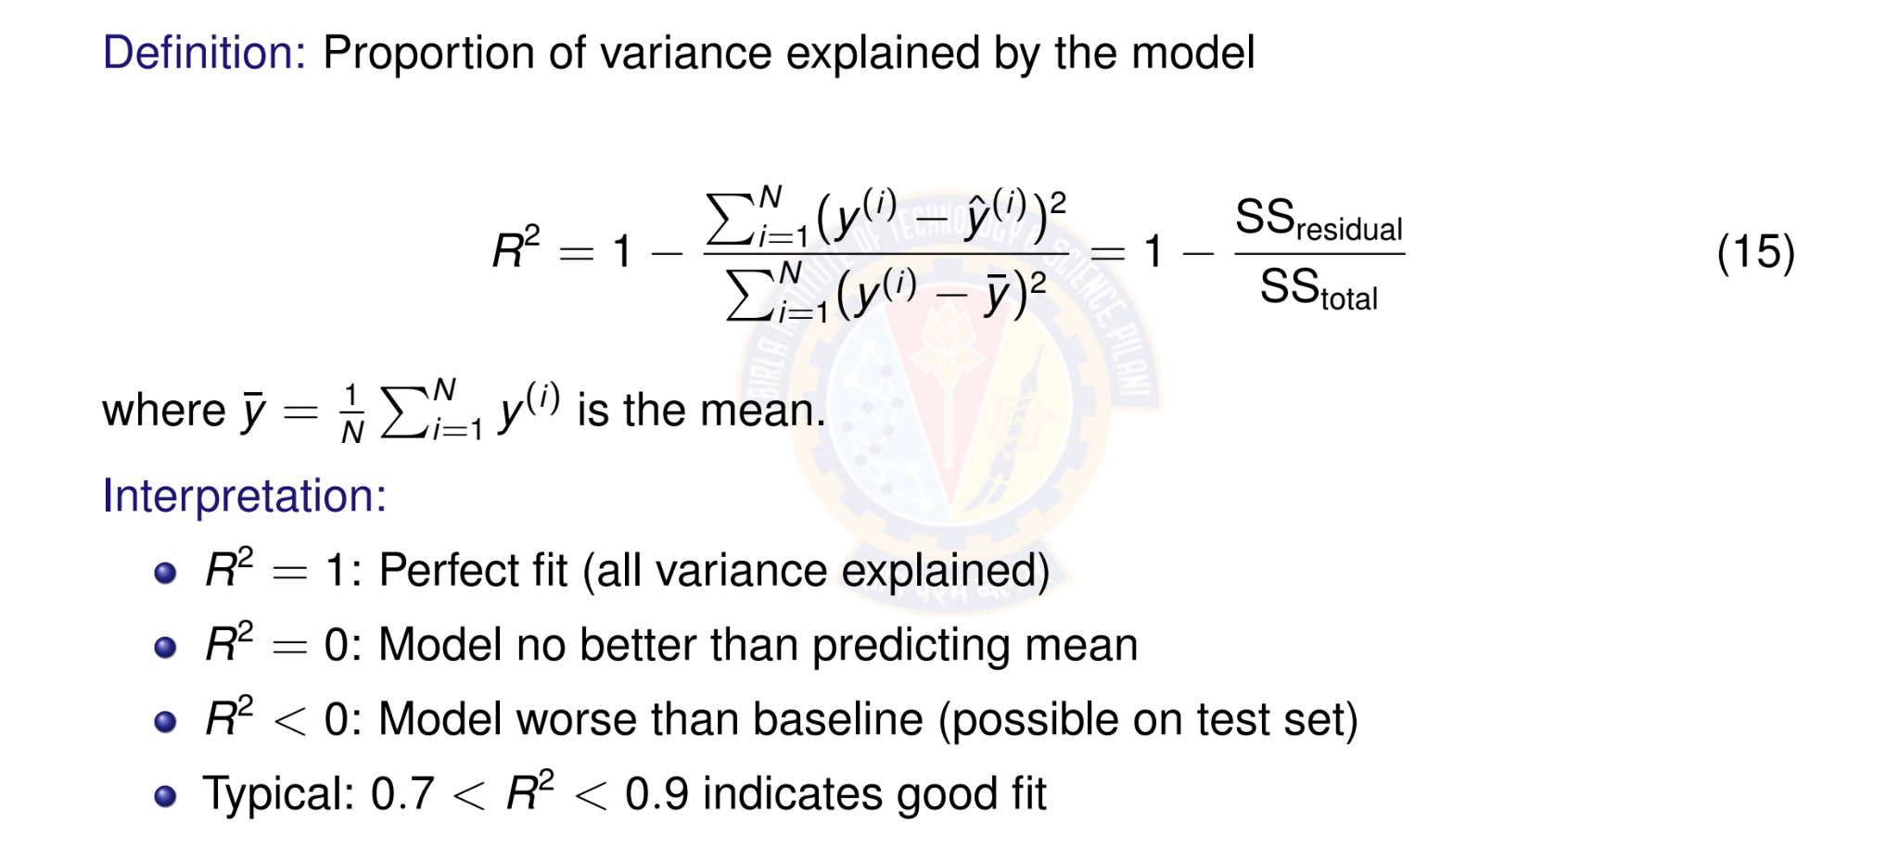
R² Score (Coefficient of Determination)
Deep Learning
Notes:
The R² (R-squared) score in linear regression is a statistical measure that represents the proportion of the variance in the dependent variable that is predictable from the independent variable(s). It's often called the coefficient of determination and indicates how well the regression model's predictions fit the actual data. A score of 1 (or 100%) means the model perfectly predicts the data, while a score of 0 means the model is no better than simply predicting the average value.
$SS_{res}$ is the "residual sum of squares," which measures the variance around the regression line (the sum of the squared differences between the actual and predicted values).
$SS_{tot}$is the "total sum of squares," which measures the total variance in the data (the sum of the squared differences between the actual values and the mean of the dependent variable).
High R²: A high R² value, closer to 1, indicates that a large portion of the variance in the dependent variable can be explained by the independent variables in the model.
Low R²: A low R² value, closer to 0, suggests that the model's predictions don't fit the data well and much of the variance is due to other factors not included in the model.
Context is key: While a higher R² is often better, the interpretation of a "good" score depends on the field of study. For example, a high R² in physics might be 0.99, but in social sciences, an R² of 0.5 might be considered strong

Slide 36

Table of Contents
Regression
Linear Regression
The Linear Model: Single Neuron
Worked Example
Evaluation
Python Implementation Implementation Tips
Summary
1
2
3
4
5
6
7
8
Deep Learning

Slide 37
Perceptron Demo Python Code
https://colab.research.google.com/drive/ 10whoZYodz1H02mbVwsmTudwxaU18ukaI?usp=sharing
Student pl note:
The Python notebook is shared for anyone who has access to the link and the access is restricted to use BITS email id. So please do not access from non-BITS email id and send requests for access. Access for non-BITS email id will NOT be granted.
Deep Learning

Slide 38

Table of Contents
Regression
Linear Regression
The Linear Model: Single Neuron
Worked Example
Evaluation
Python Implementation Implementation Tips
Summary
1
2
3
4
5
6
7
8
Deep Learning

Slide 39
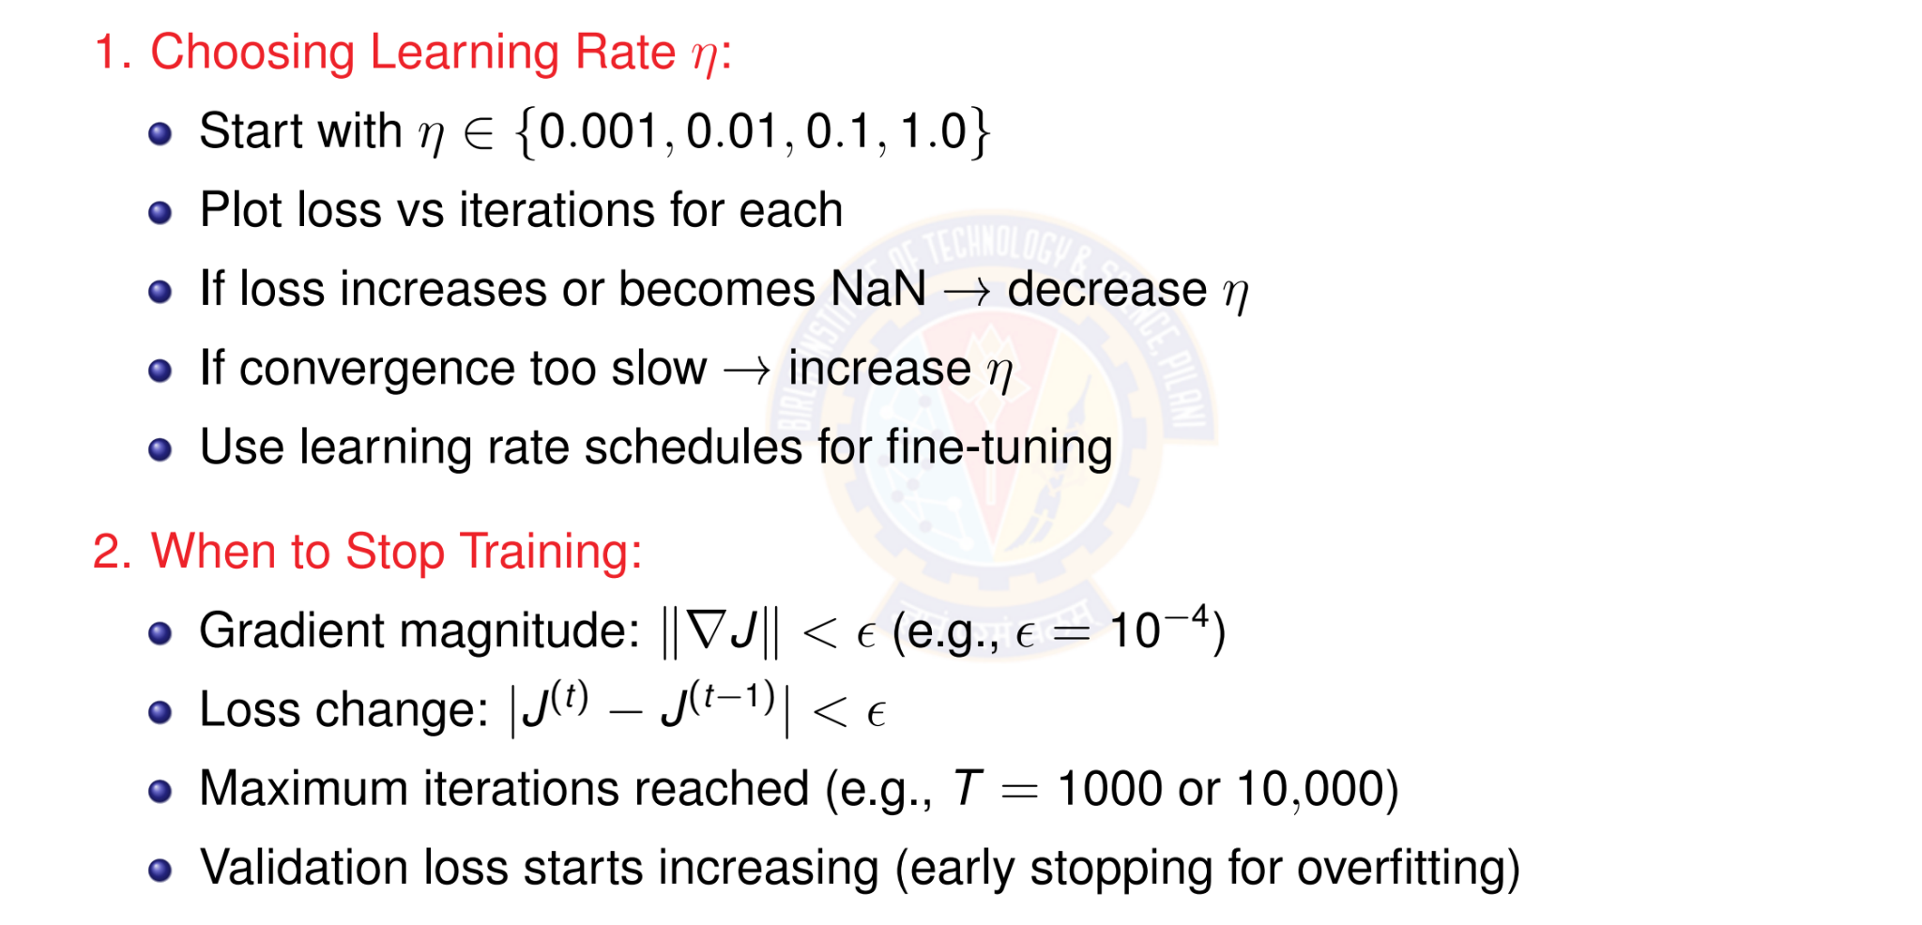
Tips for Implementation
Deep Learning

Slide 40
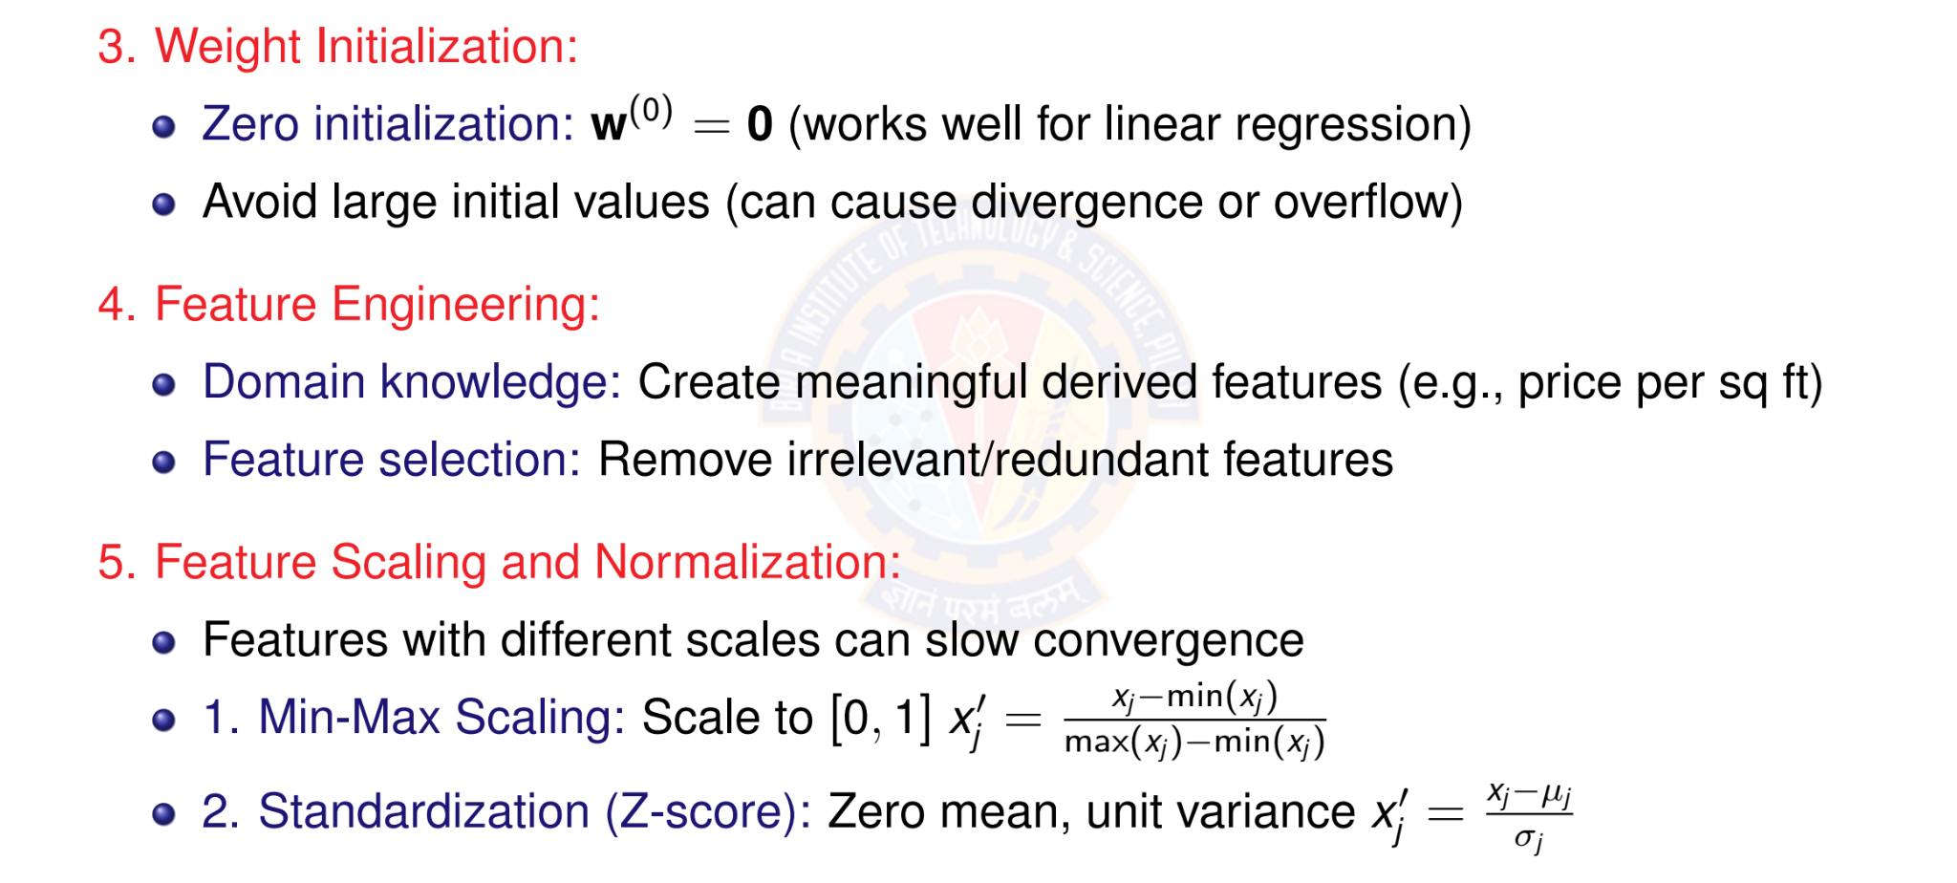
More Practical Tips
Deep Learning
40 / 46

Slide 41
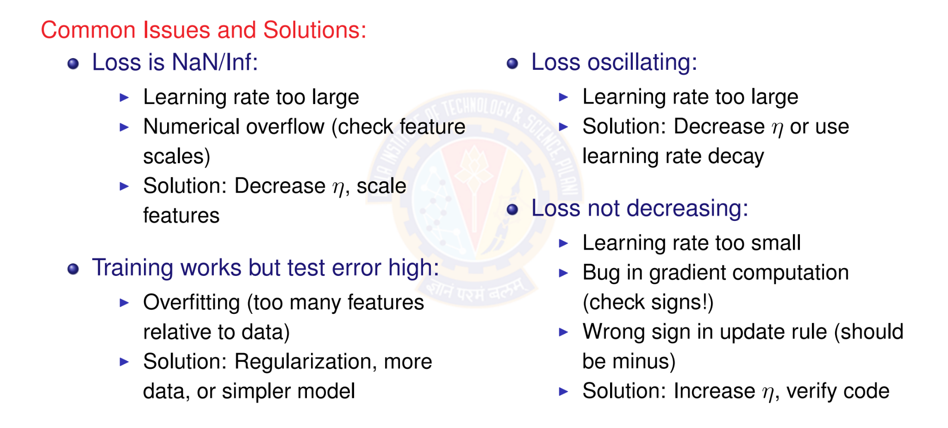
Debugging Checklist
Deep Learning

Slide 42

Table of Contents
Regression
Linear Regression
The Linear Model: Single Neuron
Worked Example
Evaluation
Python Implementation Implementation Tips
Summary
1
2
3
4
5
6
7
8
Deep Learning

Slide 43


Summary: Putting It All Together
1. Data & Initialization
D = {(x^{(i)}, y ^{(i)})}
_{w}(0) ₌ ₀
2. Model
x₁
^{x2} Σ y^{ˆ}
x_{d}
Linear Activation Function
forward
iterate
Linear Regression Model
compute
4. Learning
—η∇J
_{w}(t ) _{w}(t +1)
3. Objective
minimum
J(w)
MSE Loss Function
gradient
This framework extends to more complex models: neural networks, deep learning!
Deep Learning
Notes:
1. Data & Initialization: The process begins with a dataset $D=\left\{\left(x^{\left(i\right)} , y^{\left(i\right)}\right)\right\}$ consisting of input-output pairs. The model's weight vector $w$ is initialized, often to zero ($w^{\left(0\right)}=0$
2. Model: The initialized weights are used in a linear activation function to make a prediction $y$ based on the input features $x_{1},x_{2},…,x_{d}$.This is the "forward" pass.
3. Objective: The predicted output from the model is compared to the actual data using an objective function, specifically the Mean Squared Error (MSE) Loss Function $J\left(w\right)$.
The goal is to find the minimum point of this function, which corresponds to the best-fitting model weights.
4. Learning: The model iteratively updates the weights using a gradient-based optimization method. The negative gradient ( $−η∇J$) which indicates the direction of the steepest descent towards the minimum loss, is used to update the current weights $w^{\left(t\right)}$ to new weights $w^{\left(t+1\right)}$. This "iterate" step repeats until the model converges to a minimum loss.

Slide 44
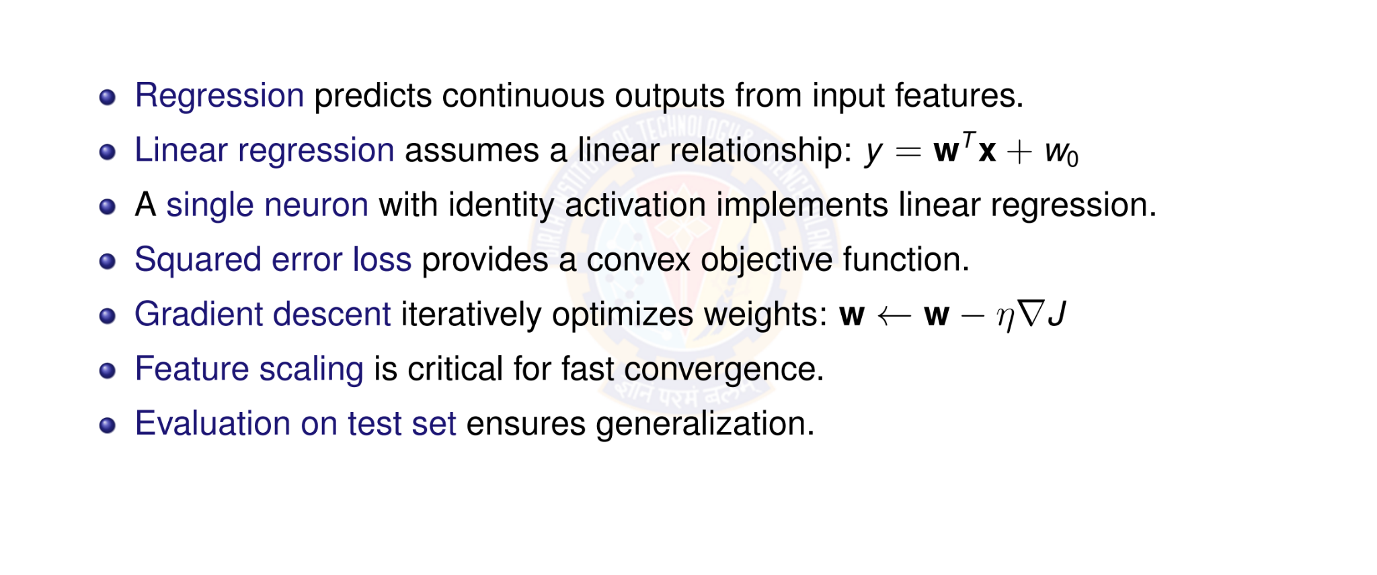
Key Takeaways
Deep Learning

Slide 45
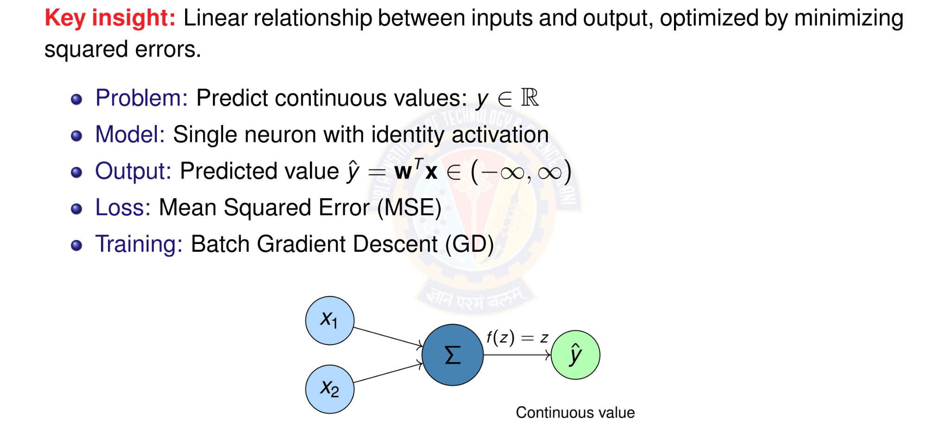
Linear Regression
Deep Learning

Slide 46

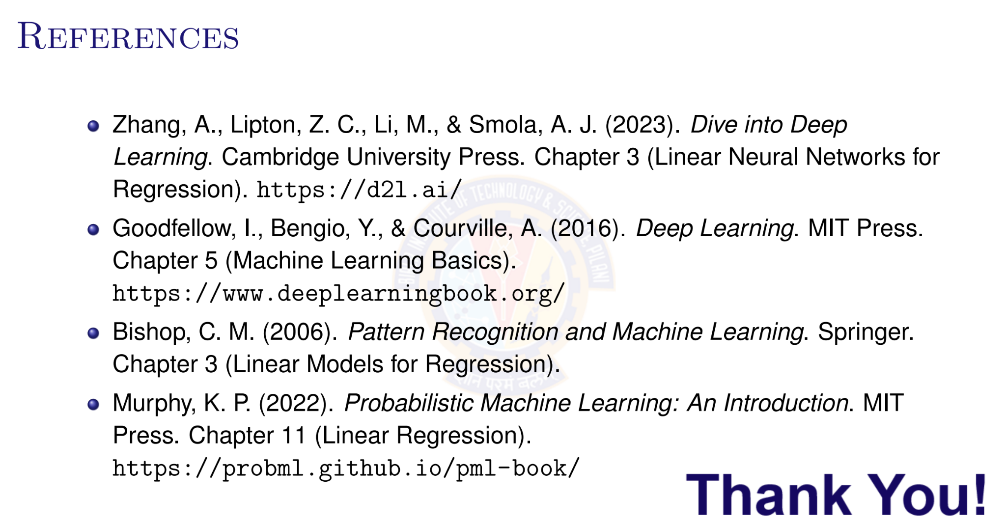
Deep Learning

